Slide 1
Unreached Community
Rural Areas
Distance Areas
Anarchy Areas
Impoverished Areas
Non-profitable Areas
Notes:
Anarchy: a state of disorder due to absence or non-recognition of authority or other controlling systems.
Impoverished: made poor

Slide 2
Physicians (per 1,000 people)
Top 5:
Cuba 8.2(2017)
Monaco 6.6(2014)
San Marino 6.1(2014)
Sweden 5.4(2016)
Austria 5.1(2016)
Notes:
https://data.worldbank.org/

Slide 3
Physicians (per 1,000 people)
Low 5:
Qatar 0(2017)
Malawi 0(2016)
Somalia 0(2014)
Sierra Leone 0(2011)
Liberia 0(2015)
Tanzania 0(2014)
Chad 0(2016)
Togo 0(2015)
Notes:
https://data.worldbank.org/

Slide 4
Physicians (per 1,000 people)
Low 5:
Burundi 0.1(2016)
Niger 0.1(2014)
Papua New Guinea 0.1(2010)
Eritrea 0.1(2004) old data
Burkina Faso 0.1(2016)
Central African Republic 0.1(2015)
Lesotho 0.1(2010)
Senegal 0.1(2016)
……
Notes:
https://data.worldbank.org/

Slide 5

Ratio of nurses to doctors 2015
TOP 5
Japan 4.6
Finland 4.6
Denmark 4.6
Switzerland 4.3
United States 4.1
Luxembourg 4.1
Iceland 4.1
Source: OECD Health Statistics 2017
Available at: http://dx.doi.org/10.1787/888933604761

Slide 6
Hospital beds (per 1,000 people)
Top 5:
Virgin Islands(U.S.) 18.7(1996) old data
Greenland 14.4(1970) old data
Monaco 13.8(2012)
Japan 13.4(2012)
Korea, Dem. People’s Rep 13.2(2012)
Korea, Rep. 11.5(2015)
Belarus 11.0(2013)
Notes:
https://data.worldbank.org/

Slide 7
Hospital beds (per 1,000 people)
Low 5:
Mali 0.1(2010)
Madagascar 0.2(2010)
Guinea 0.3(2011)
Ethiopia 0.3(2015)
Niger 0.3(2015)
Notes:
https://data.worldbank.org/

Slide 8
Total health expenditure per capita (2015)
Top 5: (in U.S. dollars)
Switzerland 9,818
United States of America 9,536
Norway 7,464
Luxembourg 6,236
Sweden 5,600
Notes:
Wiki from who

Slide 9
Total health expenditure per capita (2015)
Low 5: (in U.S. dollars)
Central African Republic 17
Democratic Republic of the Congo 20
Madagascar 21
Burundi 24
Ethiopia 24
Notes:
Wiki from who

Slide 10
Correlation (data from WHO)
Left: life expectancy-hospital
Right: heathy life expectancy-hospital

Slide 11
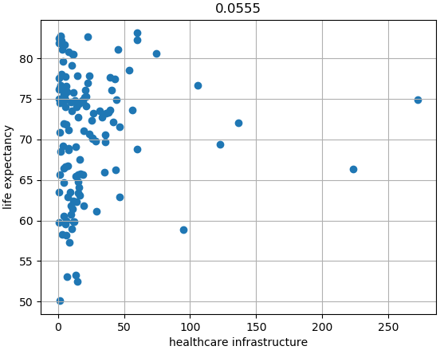
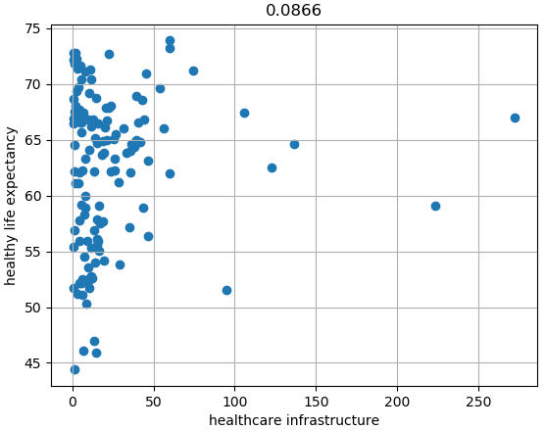
Health posts, Health centers, Hospitals

Slide 12
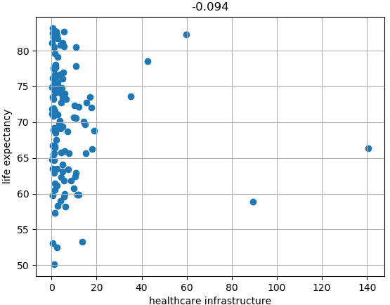
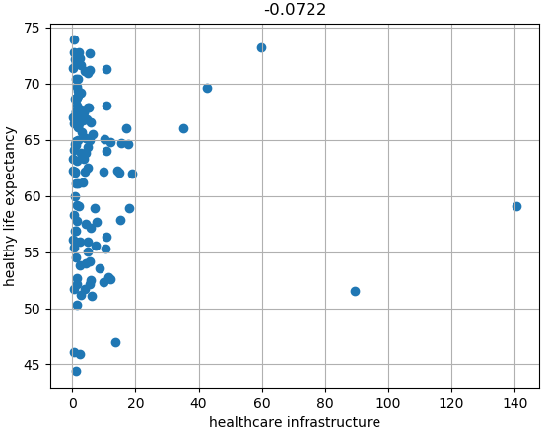
Heath centers, Hospitals

Slide 13
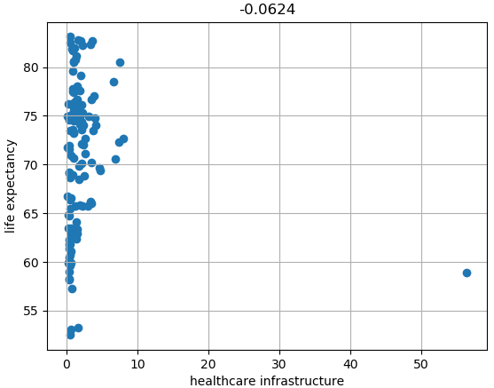
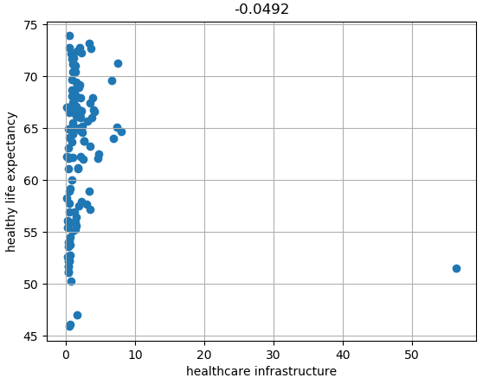
Hospitals

